Slide 1
Session Management in Express.js

Slide 2
We will cover
Stateless to Stateful HTTP ?
Working of Session
What is Cookie?
What is Session?
Why use Session?
Creating Cookie with ExpressJS

Slide 3
Stateless to Stateful HTTP ?
HTTP is stateless.
In order to associate a request to any other request, you need a way to store user data between HTTP requests.
Cookies and URL parameters are both suitable ways to transport data between the client and the server. But they are both readable and on the client side.
Sessions, created on server side, solve exactly this problem. You assign the client an ID and it makes all further requests using that ID.
Information associated with the client is stored on the server linked to this ID.

Slide 4
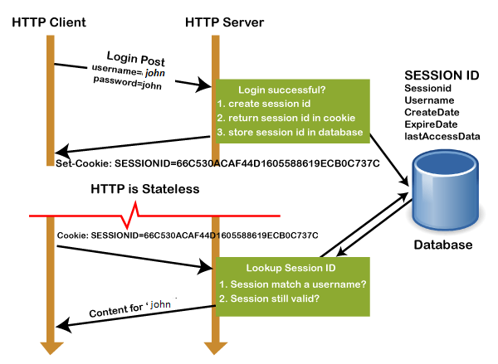
Working of Session

Slide 5
Working of Session
Client request to the server via GET or POST method.
The sessionID is created on the server, and it saves the sessionID into the database. It returns this sessionId with a cookie as a response to the client.
On further request cookie with sessionID stored on the browser is sent back to the server.
The server matches this id with the saved sessionID and sends a response HTTP200

Slide 6
What is Cookie?
A cookie is a small text file that is stored on the user's computer. The maximum file size of a cookie is 4KB. It is also known as an HTTP cookie, web cookie, or internet Cookie.
Whenever a user visits a website for the first time, the site sends packets of data in the form of a cookie to the user's computer.
The cookies help the websites to keep track of the user's browsing history or cart information when they visit their sites.
It stores only the "String" data type.
The information stored within cookies is not secure because this information is stored in text-format on the client-side, which can be read by anyone.
We can enable or disable the cookies as per the requirement.

Slide 7
What is Cookie?
The cookies generated by a user are only be shown to them, and no other user can see those cookies.
Cookies are created and shared between the server and browser with the help of an HTTP header.
The path where the cookies are saved is decided by the browser, as Internet explorer usually stored them in Temporal Internet File Folder.
When we visit YouTube channel and search for some songs, next time whenever we visit YouTube, cookies read our browsing history and shows similar songs or last played songs.

Slide 8
What is a Session?
A session is used to temporarily store the information on the server to be used across multiple pages of the website.
It is the total time used for an activity. The user session starts when he logs-in to a particular network application and ends when the user logs out from the application or shutdowns the system.
The user information is stored in session variables, and these variables can store any type of value or data type of an Object.

Slide 9
What is a Session?
Session values are much secured as these are stored in binary form or encrypted form and can only be decrypted at the server.
The session values are automatically removed when the user shutdowns the system or logout from the application.
To store the values permanently, we need to store them in the database.
Each session is unique for each user, and any number of sessions can be used in an application; there is no limitation to it.

Slide 10
What is a Session?
sessionID :
The user is identified with the help of sessionID, which is a unique number saved inside the server. It is saved as a cookie, form field, or URL.

Slide 11
Why use Session?
Sessions are used to store information such as UserID over the server more securely, where it cannot be tempered.
It can also transfer the information in the form of value from one web page to another.
It can be used as an alternative to cookies for browsers that don't support cookies to store variables in a more secure way.

